Slide 1

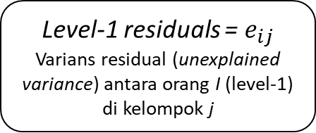

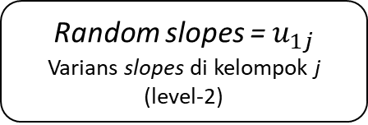
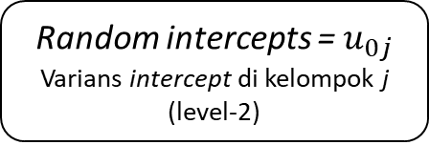

Random intercepts = $u_{0j}$
Varians intercept di kelompok j (level-2)
$$u_{0j}=b_{0j}−c_{00}$$
$$u_{1j}=b_{1j}−c_{10}$$
Random slopes = $u_{1j}$
Varians slopes di kelompok j (level-2)
Level-1 residuals = $e_{ij}$
Varians residual (unexplained variance) antara orang I (level-1) di kelompok j
$$e_{ij}=y_{ij}−{\hat{y}}_{ij}$$

